Slide 1
MBC 638 M410
Project Desktop Challenge
John Christman

Slide 2
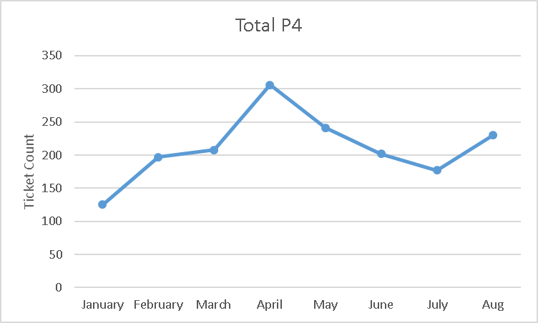
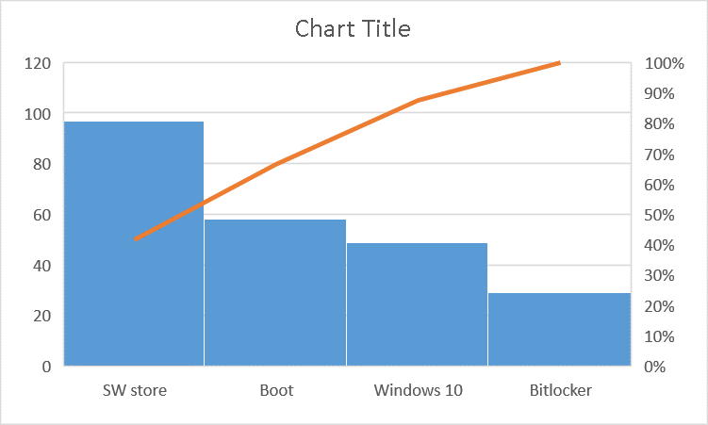
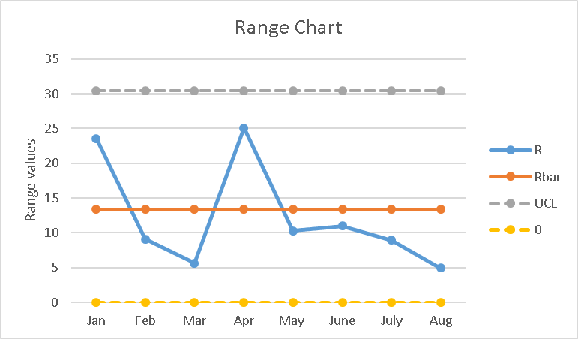
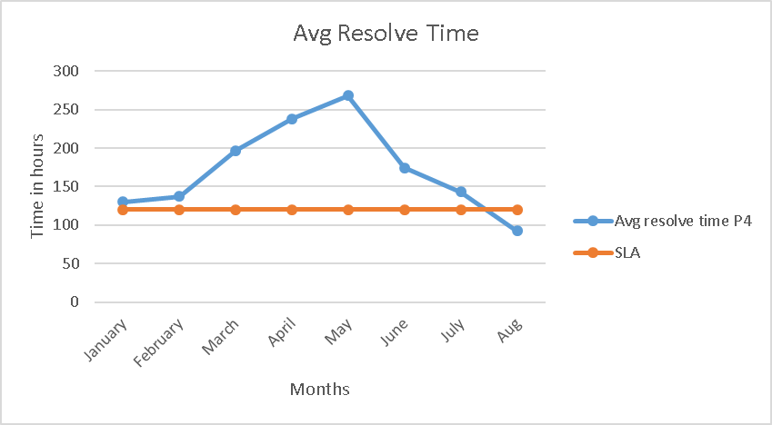
Process Improvement Project - Meeting the SLA Process Improvement lead: John Christman
Timeline: Project Kick-off 7/11 | Define 7/12 – 7/18 | Measure 7/19 – 8/8 | Analyze 8/9 – 8/22 | Improve 8/23 – 9/5 | Control 9/6 forward
DEFINE | MEASURE | ANALYZE | IMPROVE | CONTROL
The service level agreement (SLA) target for desktop Incident tickets is 5 days. The average over the last 6 months is double the SLA target. Tickets are not getting closed out in time and customer feedback indicates it is taking too long to resolve the tickets. There are 4 primary opportunities for delay that will be considered as defects. Current SQL is 2.9* *based on 6 months of data | Ticket level is steady Time to resolve is varies And the average time to resolve is too long. Perform a root cause analysis. Collect ticket resolution data. Determine central tendencies and graph run charts. Plot XMR and moving avg. | Ticket volume identified as a root cause. Additional factors include ticket type. Time of the month and ticket type Pareto also show a trend. No trends found by analyst. Solution: 2 part time analysts were added in April and a full time in August finally bringing the SLA within limits | Two part time analysts added in April, Full time added in August. Lowers PC to analyst ration to 500:1 Re-evaluated SQL is 3.2* *based on 1 month data | Monitor trend to ensure it is maintained. Look for additional opportunities to lower the defect rate* *maintaining the SLA with fewer tech adds additional cost savings $$$$$
Business Impact: The average hourly cost per employee times the average time the SLA is exceeded is $5400 per ticket.

Slide 3
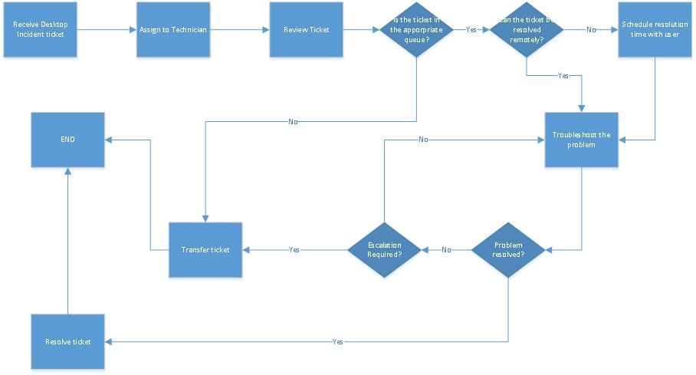
The Current Process Problem statement: Desktop Incident tickets for my work site are not resolved within the specified SLA. Tickets are not getting closed out in time and customer feedback indicates it is taking too long to resolve the tickets. The average over the last 6 months is double the SLA target
Define
Start to finish SLA is 120 hours.
Defect opportunities
Opportunities exist to streamline the process

Slide 4
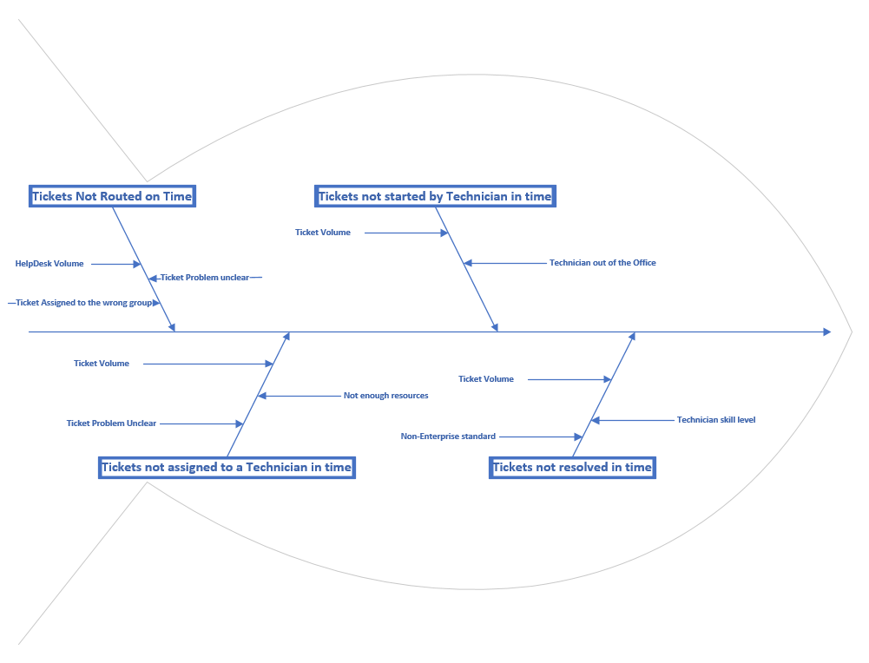
Root Cause Analysis - Ishikawa
Define
Ticket volume is a pervasive contributor to missed SLAs at every defect point in the process

Slide 5
Data Stratification Tree
Measure
Questions About Process
Stratification factors
X Variables
Measurements
Are completion times impacted by the desktop tech skill-levels?
Skill level
Monthly average ticket resolutions time
Missed SLAs by month
Are completion times impacted by the ticket subject?
Type of call
Missed SLA times by tech
Total tickets per month
% Missed SLAs of the total ticket count
%Missed SLAs of the total assigned by tech
Total/% failing tickets days 1-15 calls
Total/% failing tickets days 16-EOM calls
Do techs receive the tickets in time to complete within the SLA?
Receipt of call
Do ticket completion times correlate to ticket volume?
Ticket volume
New Orders
Are parts availability impacting SLA success?
(Output Y)
Parts availability
Time of day of call
Does the time of day impact SLA success?
Does the week of month impact SLA success?
Week of the call

Slide 6
Data Details
Measure
• The data was extracted from our ticketing system and included the following fields
Call #, Asset Tag, Service, Type, Call Priority, Logged Date/Time, Problem Description, User Name, Organization, Location, Ticket Status, Current Analyst, Resolve Status, Assigned Group, Resolved Date/Time
• The resolution time duration was calculated by subtracting the Logged Date/Time from the Resolved Date/Time
• For the purpose of this study, the tickets were filtered to reflect just Priority 4.
Break/fix at the user level
Service level agreement for these tickets is 120 hours. (5 days)
• The time data analyzed was continuous. The failures based on when the ticket was logged is discreet (failed or didn’t fail the SLA)
• Additional inputs included:
The type of problem
The analyst that resolved the ticket
The ½ of the month that the ticket was logged.
Ticket resolution time = Resolve time – logged time. Goal is 120 hours

Slide 7
Data Collection
Measure
• Data was collected using a query in the corporate ticketing system.
• All tickets were collected by month from Jan-Aug 2019 and filtered to Priority 4 tickets.
• Population totaled 1686 tickets.
• Mean: 186 hours 41 minutes. Median: 145 hours. There was no Mode as ticket resolution times are measured down to the minutes. Sigma = Sqrt (Mean((x-mean)^2) = 174 hours 41 minutes. Variance : sigma^2 = 1967 hours 34 minutes
• Sample size with a desired confidence of 95% and an error of 24 hours is 204 data points
• Separated missed tickets by those logged between the 1st-15th of the month and 16th- end of the month
•Identified top 4 most common ticket problems. Counted the misses as a percentage of the total tickets per category
•Counted the tickets missed by analyst per month

Slide 8

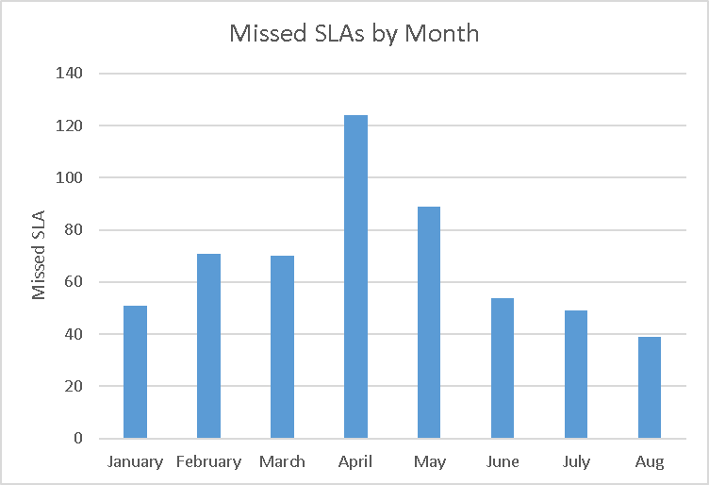
Analyze
Crossing below SLA target
Trend line
Measures of central tendency and run charts

Slide 9
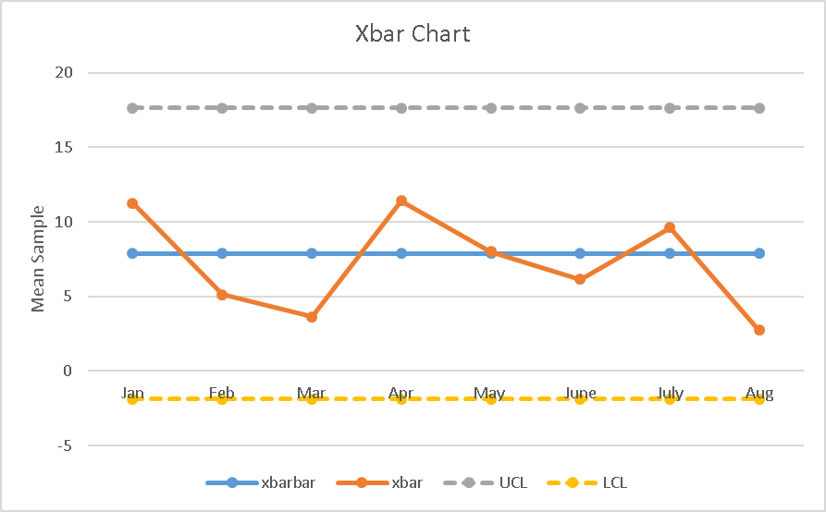
Sample data . A portion of the data is redacted
Part time employees added in May. Full time in August

Slide 10
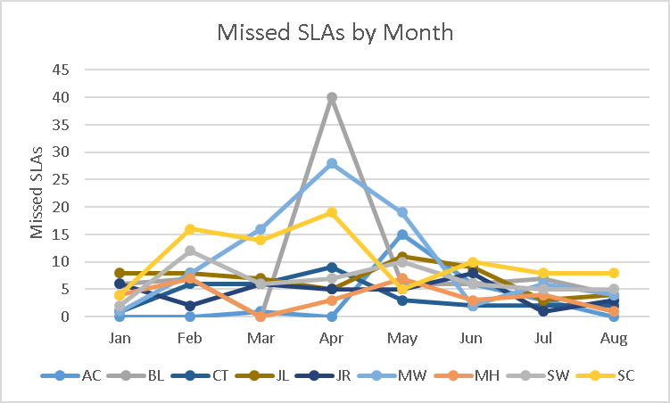
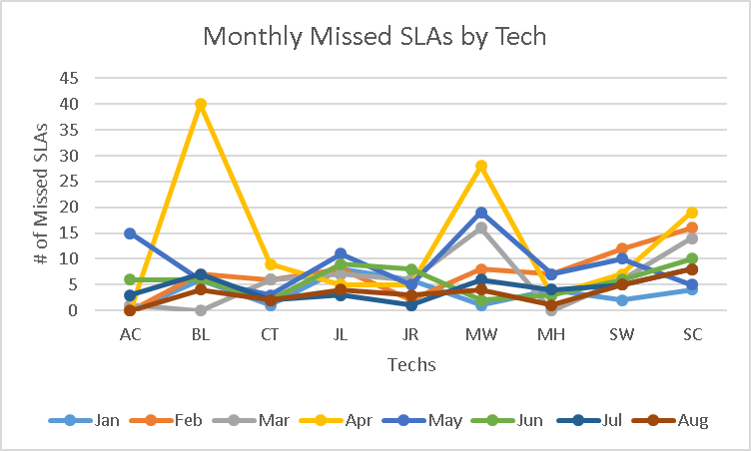
Other data views – Does the assigned analyst matter?
No visual trends
Failures are consistent across the analysts and are inline with the monthly failures

Slide 11
Pareto chart of the tickets of the top 4 tickets that miss the SLA
• Reviewed the problem description to identify common causes of tickets. 4 issues were identified with the highest occurrence; Software Store, Boot, Windows 10 and Encryption (Bitlocker) issues
• Counted the missed SLAs for each category
• This presents an opportunity to further improve the SLA performance or reduce analyst count and maintain SLA performance
Focusing on improving the software installation process would significantly reduce the amount of SLA failures

Slide 12
Missed SLAs by half of the month
• Counted the missed SLAs for tickets logged between the 1st and the 15th of the month and those logged during the 16th through the end of the month.
Could the analysts be less concerned about meeting SLAs in the first half of the month?

Slide 13
Measurement Error
Since the resolution time is a calculation based on system generated times, the measurement error comparing each result approaches zero.
However, while the log date and time is based on the initial user request, the resolution date and time are based on the analyst closing the ticket in the system. If an analyst were to delay or prematurely resolve the ticket, it would introduce error into the resulting duration.
Analysts are trained on the impact of incorrect resolution times and given the size of the sample, individual errors should be smoothed out over time.
Without automating the ticket resolution or by ticket interviews, it would be difficult to reduce the error

Slide 14
Conclusions
• In December 2018 the analyst staff was reduced by 50%
• SLA performance from January 2019 – July 2019 on P4 tickets exceeded the SLA goal of 120 hours from log time to resolution time
• 3 Part time analysts were added in April. A corresponding downward trend in resolution times is evident in the run charts.
• A full time analyst was added in August and the SLA target was finally met.
• Neither the XMR nor the moving average show a result outside of the limits however there is only one data point with the current staffing level
• SQL improved by 0.3 from 2.9 to 3.2.
Adding analysts improved SLA performance

Slide 15
Next Steps
• Two additional views into the data
There is a difference in resolution time based on which half of the month the ticket is logged
Would increasing visibility of SLA performance earlier in the month lead to overall better performance?
Data shows large volume of missed SLAs based on one type of ticket
Investigate why the software store tickets are taking the longest to resolve. Improving the software store process or the resolution steps for these tickets would have the greatest impact of all ticket types on reducing SLA failures
•Continued improvement of SLA performance supports a reduction in analyst staff which would add cost savings and/or allow better performance during surge events
More Opportunities for Improvement!

